Slide 1
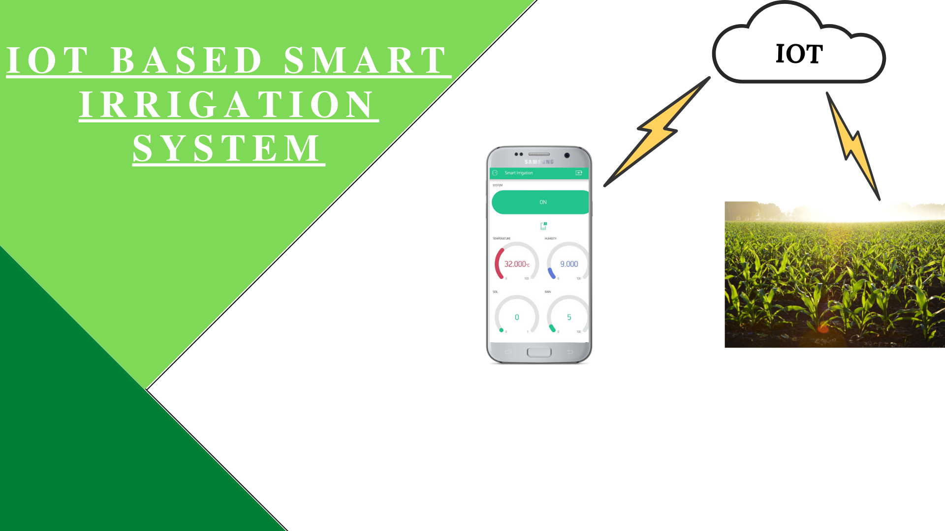
Presented by :
Dhruvi Shah AU2040263
Kinal Kagathara AU2040240
Akshat Shah AU2040052
Prasham Mehta AU2040102
Madhvendrasinh Jhala AU2040162
Omkar Pandya AU2040180

Slide 2
Outline of Presentation
1. Problem Summary
2. Problem Solving
3. Block Diagram
4. Circuit Diagram
5. Flow Chart
6. Advantages
7. Limitations
8. Future scope
9. Components
10. References & Bibliography

Slide 3
Problem Summary
Farming is one of the works which is expected to be done under personal observation and it also requires a lot of persistence, attention and maintenance.
Watering the crop is the most important step in farming.

Slide 4
Problem Summary
For every crop, there is different need of water supply which also depends upon the type of soil the field has.
Lack of this knowledge results into either dryness or water logging. Both the conditions result into the failure of the crop.

Slide 5
Problem Solution
IOT BASED SMART IRRIGATION SYSTEM
Uses sensors to take decisions on it’s own.
The data from the sensors in soil taken as a sample is sent to phone wirelessly (WIFI for now) and is also processed to configure the water pump to switch on and switch off on its own.

Slide 6
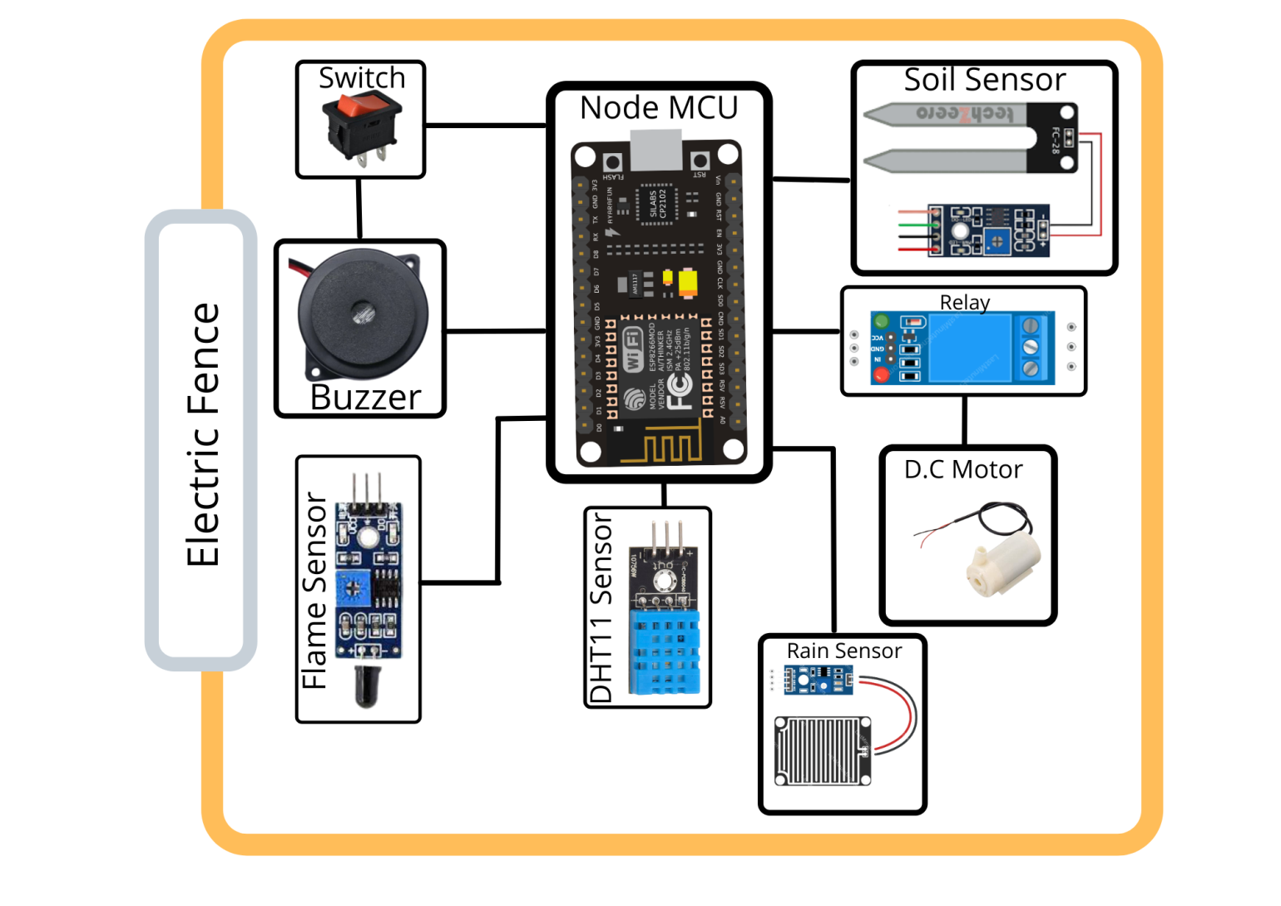
Block Diagram

Slide 7
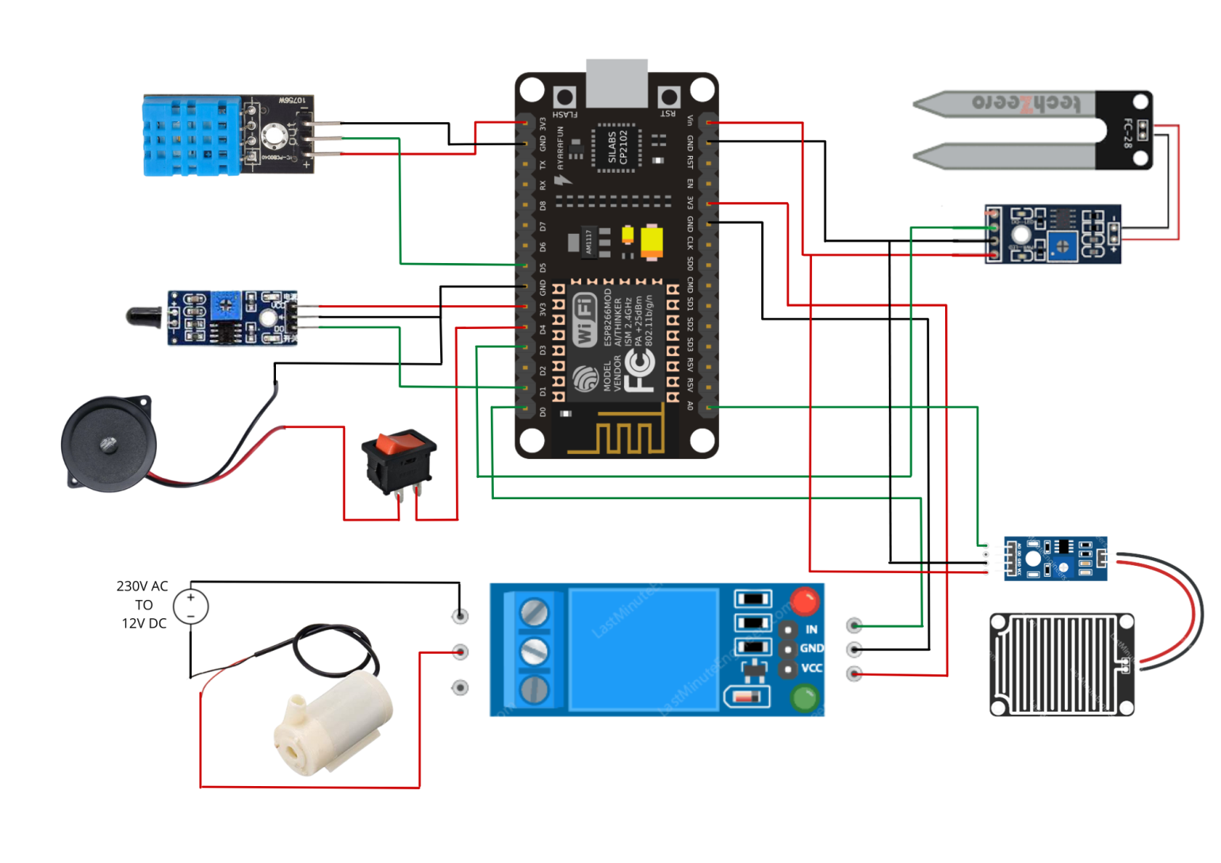
Circuit Diagram

Slide 8
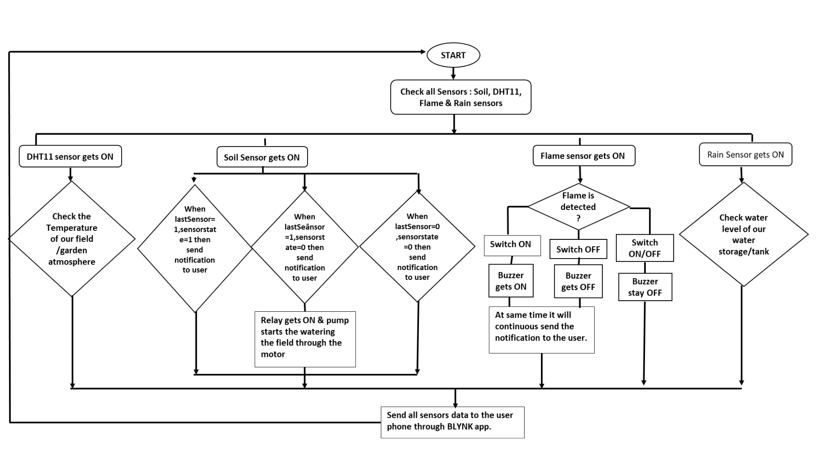
Flow Chart :

Slide 9
WEBSITE:
https://sites.google.com/ahduni.edu.in/group-03-farmers-problem/home

Slide 10
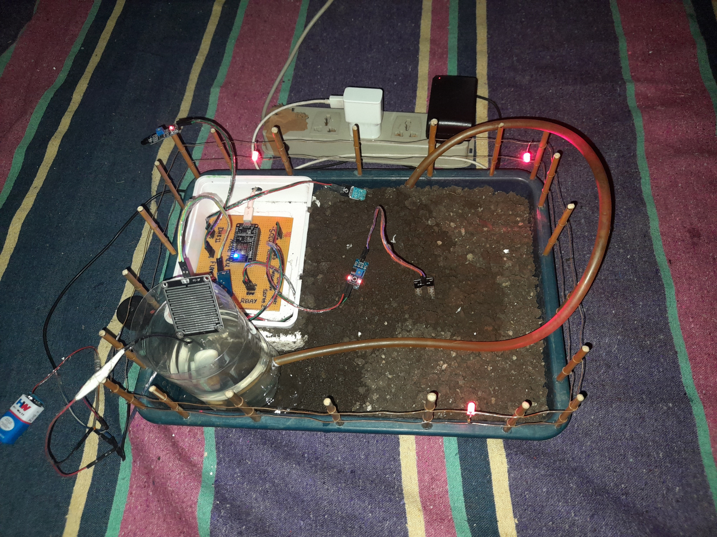
Prototype model

Slide 11
Advantages
Real time data of the soil moisture, humidity, water level in the tank and ambient temperature can checked and monitored using phone.
The productivity of the crop can be increased with minimal wastage of water and electricity.
Any soil sample can be tested and the water pump can be configured accordingly.

Slide 12
Limitations
The data related to soil, pump capacity, etc. is to be entered manually, which may cause human error (in our system).
The data read by the sensors is not stored. Hence, it can’t be reused.
We need to depend on third party application like BLYNK.
Any physical damage to the sensors leads to wrong data reading.

Slide 13
Future Scope
We can add more functionalities like pH level, humous content, etc. of the soil with the help of different sensors
We can save the data in cloud for future reference.
We can develop an application which can display and record the data remotely (not through WIFI)

Slide 14
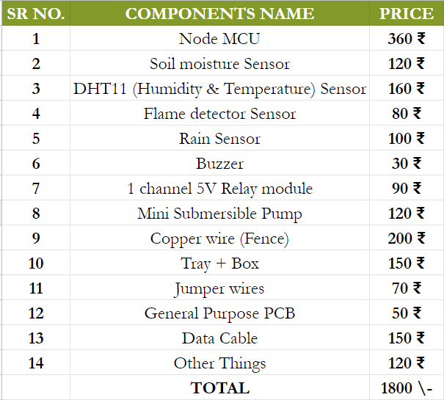
Components list & costing

Slide 15
Thank You

Slide 16
References & Bibliography
Reference :
Building an IoT Node for less than 15$ book by Clause Kuhnel
Internet of things with ESP8266 book by Marco Schwartz.
Smart Irrigation System in Agriculture article by S. P. Vimal.
Smart Irrigation – the future of Automated & connected farming by AgriTech Tomorrow.com
Bibliography :
https://docs.blynk.cc
https://lastminuteengineers.com/
https://srituhobby.com
www.youtube.com/c/viralscience
www.viralsciencecreativity.com
www.randomnerdtutorials.com

